Slide 1
Introduction to Network & Data Communication

Slide 2
Network
A network is a collection of computers and devices connected together via communications devices and transmission media.
A network consist of two or more entities for the purpose of sharing resources and information.
Advantages of using a network include:
Facilitating Communications
Sharing Hardware
Sharing Data and Information
Sharing Software
Transferring Funds etc.

Slide 3
Classification of a Computer Network based on Geographical Location
2

Slide 4
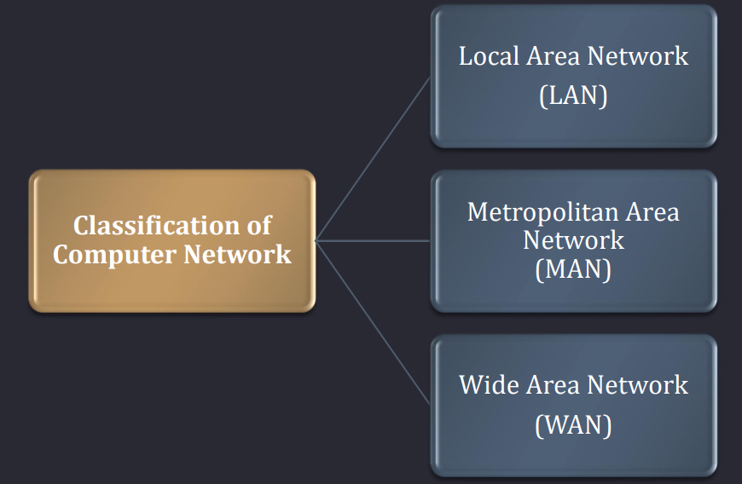

Slide 5
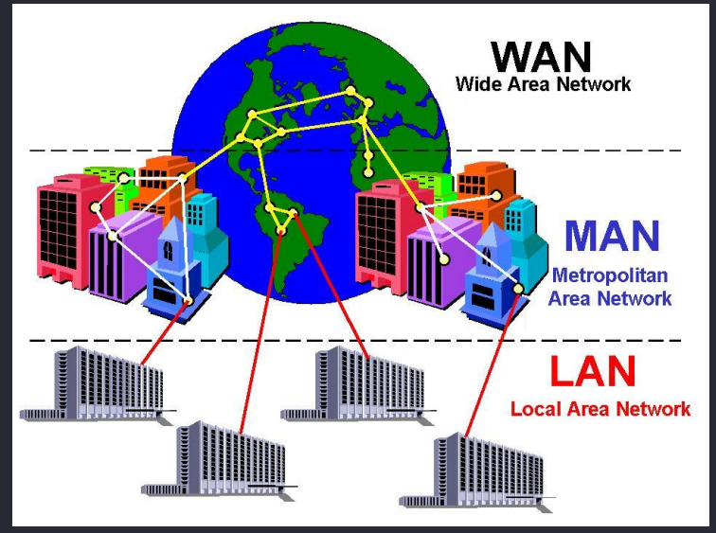

Slide 6
LAN (Local Area Network)
A local area network (LAN) is a network that connects computers and devices in a limited geographical area.
Example such as a home, school computer laboratory, office building or closely positioned group of buildings.
The simplest form of LAN is to connect two computers together.
A network which consists of less than 500 interconnected devices across several buildings, is still recognized as a LAN.

Slide 7
Advantages of a LAN :
Easy to share devices (printers, scanners, external drives)
Easy to share data (homework, pictures)
Cost of LAN Setup is low
Disadvantages of a LAN :
Power - a good LAN is required to be on all the times
Security - each computer and device become another point of entry for undesirables
If all computers running at once, can reduce speed for each
Area covered is limited

Slide 8
MAN (Metropolitan Area Network)
A Metropolitan Area Network (MAN) is a high-speed network that connects local area networks in a metropolitan area. Example such as a city or town which handles the bulk of communications activity across that region.
It is designed to extend over an entire city. It may be a single network such as cable television network available in many cities.
Range: Within 100 km (a city).
Campus Area Network (CAN) is a type of MAN

Slide 9
Advantages of a MAN :
It provides a good back bone for a large network and provides greater access to WANs.
The dual bus used in MAN helps the transmission of data in both direction simultaneously.
A Man usually encompasses several blocks of a city or an entire city.
Disadvantages of a MAN :
More cable required for a MAN connection from one place to another.
It is difficult to make the system secure from hackers and industrial espionage (spying) graphical regions.

Slide 10
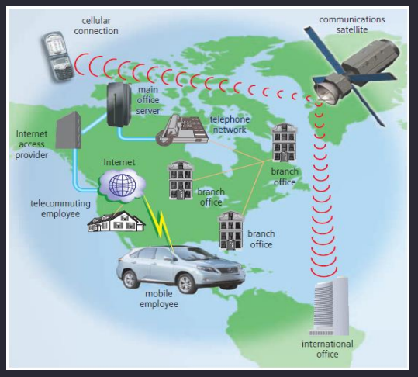
WAN (Wide Area Network )
A Wide Area Network (WAN) is a network that covers a large geographic area (such as a city, country, or the world) using a communications channel that combines many types of media such as telephone lines, cables, and radio waves.
Network that provides long distance transmission of data, voice, image and video information over large geographical areas that may comprise a country, a continent.
Range: Beyond 100 km.
The Internet is the world’s largest WAN.

Slide 11
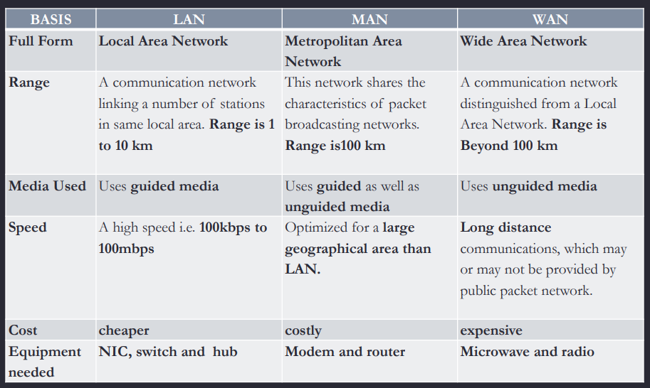
Difference between LAN, WAN and MAN
NIC → Network Interface Card

Slide 12
Classification of a Computer Network based on Component Roles
2

Slide 13
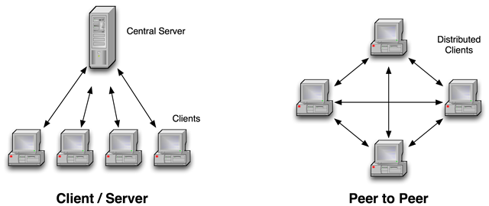
Client-Server Network
Large organizations are likely to have more than one server.
Each server carries out a different role on the network:
Manage printing
Manage email
Manage files
Once connected to the servers clients will have access to features such as:
Dedicated storage
Files (if the user has the access rights)
Software used within the company
Peripheral devices such as printers and scanners (if connected)

Slide 14
Peer-to-Peer (P2P)
P2P networks require no server.
Each connected computer performs its own functions but can share files and resources.
Each computer is considered equal to it’s peers.
These types of networks are usually found in the home or in smaller organizations and are much easier to set up compared to Client-Server networks.

Slide 15
Internet Protocol
IP is short for the Internet Protocol. IP is the name of a protocol file with small content. It defines and describes the format of IP packets.
The frequently mentioned IP refers to any content related directly or indirectly to the Internet Protocol, instead of the Internet Protocol itself.
Function
Version
Provides logical addresses for devices at the network layer.
Is responsible for addressing and forwarding data packets.
IP Version 4 (IPv4)
IP Version 6 (IPv6)

Slide 16
What Is an IP Address?
An IP address identifies a node (or an interface on a network device) on a network.
IP addresses are used to forward IP packets on the network.
What is a Ping ?
Ping stands for Packet InterNet Groper . Ping is a computer network utility used to test the reachability of a host (typically a computer or server) on an Internet Protocol (IP) network. It also measures the round-trip time it takes for a data packet to travel from the source to the destination and back.
What is DNS ?
DNS stands for Domain Name System. It is a decentralized naming system that translates human-readable domain names into IP addresses, which are used by computers to identify each other on a network
Example: - www.example.com instead of numerical IP addresses.

Slide 17
IP Address Notation
An IPv4 address is 32 bits long.
It is in dotted decimal notation
IPv4 address range is 0.0.0.0–255.255.255.255.
Dotted decimal notation
Decimal
192. | 168. | 10. | 1
11000000 | 10101000 | 00001010 | 00000001
4 bytes
Binary
32 bits
Power
2⁷ | 2⁶ | 2⁵ | 2⁴ | 2³ | 2² | 2¹ | 2⁰
128 | 64 | 32 | 16 | 8 | 4 | 2 | 1
Conversion between decimal and binary systems
Bit
1 | 1 | 0 | 0 | 0 | 0 | 0 | 0
= 128 + 64 = 192

Slide 18
IP Address Structure
Network part: identifies a network.
Host part: identifies a host and is used to differentiate hosts on a network.
Network part | Host part
Network mask: is used to distinguish the network part from the host part in an IP address.
192. | 168. | 10. | 1
192.168.10.1
1 | 1 | 0 | 0 | 0 | 0 | 0 | 0
1 | 0 | 1 | 0 | 1 | 0 | 0 | 0
0 | 0 | 0 | 0 | 1 | 0 | 1 | 0
0 | 0 | 0 | 0 | 0 | 0 | 0 | 1
IP address
255.255.255.0
1 | 1 | 1 | 1 | 1 | 1 | 1 | 1
1 | 1 | 1 | 1 | 1 | 1 | 1 | 1
1 | 1 | 1 | 1 | 1 | 1 | 1 | 1
0 | 0 | 0 | 0 | 0 | 0 | 0 | 0
Network mask
Network part
Host part
Written as
192.168.10.1 255.255.255.0 = 192.168.10.1/24

Slide 19
IP Addressing
Network part (network ID): identifies a network.
Host part: identifies a host and is used to differentiate hosts on a network.
MAC Address ?
A MAC address, or Media Access Control address, is a unique identifier assigned to a network interface controller (NIC) for communication on a network.
A MAC address is typically a 48-bit (6-byte) identifier, often represented as a series of six pairs of hexadecimal digits separated by colons (e.g., 01:23:45:67:89:ab).
The first 24 bits of a MAC address represent the OUI, which is assigned to the device manufacturer or organization. The remaining 24 bits are assigned by the manufacturer to uniquely identify the specific device.

Slide 20
IP Address Types
A network range defined by a network ID is called a network segment.
Network address: identifies a network.
Example: 192.168.10.0/24
192. | 168. | 10. | 00000000
Note
Broadcast address: a special address used to send data to all hosts on a network.
Network and broadcast addresses cannot be directly used by devices or their interfaces.
Number of available addresses on a network segment is 2^{n} – 2 (n is the number of bits in the host part).
Example: 192.168.10.255/24
192. | 168. | 10. | 11111111
Available addresses: IP addresses that can be allocated to device interfaces on a network.
Example: 192.168.10.1/24
192. | 168. | 10. | 00000001

Slide 21
IP Address Classification (Classful Addressing)
To facilitate IP address management and networking, IP addresses are classified into the following classes:
Class A
0NNNNNNN
NNNNNNNN
NNNNNNNN
NNNNNNNN
0.0.0.0–127.255.255.255
Class B
10NNNNNN
NNNNNNNN
NNNNNNNN
NNNNNNNN
128.0.0.0–191.255.255.255
Assigned to hosts
Class C
110NNNNN
NNNNNNNN
NNNNNNNN
NNNNNNNN
192.0.0.0–223.255.255.255
Class D
1110NNNN
NNNNNNNN
NNNNNNNN
NNNNNNNN
224.0.0.0–239.255.255.255
Used for multicast
Class E
1111NNNN
NNNNNNNN
NNNNNNNN
NNNNNNNN
240.0.0.0–255.255.255.255
Used for research
Default subnet masks of classes A, B, and C
Class A: 8 bits, 0.0.0.0–127.255.255.255/8
Class B: 16 bits, 128.0.0.0–191.255.255.255/16
Class C: 24 bits, 192.0.0.0-223.255.255.255/24
Network part
Host part

Slide 22
IP Address Calculation
Example: What are the network address, broadcast address, and number of available addresses of class B address 172.16.10.1/16?
172. | 16. | 00001010. | 00000001
IP address
1 | 0 | 1 | 0 | 1 | 1 | 0 | 0
0 | 0 | 0 | 1 | 0 | 0 | 0 | 0
0 | 0 | 0 | 0 | 1 | 0 | 1 | 0
0 | 0 | 0 | 0 | 0 | 0 | 0 | 1
Network mask
1 | 1 | 1 | 1 | 1 | 1 | 1 | 1
1 | 1 | 1 | 1 | 1 | 1 | 1 | 1
0 | 0 | 0 | 0 | 0 | 0 | 0 | 0
0 | 0 | 0 | 0 | 0 | 0 | 0 | 0
The network address is obtained, with all host bits set to 0s.
Network address
1 | 0 | 1 | 0 | 1 | 1 | 0 | 0
0 | 0 | 0 | 1 | 0 | 0 | 0 | 0
0 | 0 | 0 | 0 | 0 | 0 | 0 | 0
0 | 0 | 0 | 0 | 0 | 0 | 0 | 0
172.16.0.0/16
The broadcast address is obtained, with all host bits set to 1s.
Broadcast address
1 | 0 | 1 | 0 | 1 | 1 | 0 | 0
0 | 0 | 0 | 1 | 0 | 0 | 0 | 0
1 | 1 | 1 | 1 | 1 | 1 | 1 | 1
1 | 1 | 1 | 1 | 1 | 1 | 1 | 1
172.16.255.255/16
Number of IP addresses
2¹⁶ = 65536
Quiz
Number of available addresses
2¹⁶ – 2 = 65534
Example: What are the network address, broadcast address, and number of available addresses of class A address 10.128.20.10/8?
Range of available addresses
172.16.0.1/16–172.16.255.254/16

Slide 23
Public IP address: An IP address is assigned by the Internet Assigned Numbers Authority (IANA), and this address allocation mode ensures that each IP address is unique on the Internet. Such an IP address is a public IP address.
Private IP address: In practice, some networks do not need to connect to the Internet. For example, on a network of a lab in a college, IP addresses of devices need to avoid conflicting with each other only within the same network. In the IP address space, some IP addresses of class A, B, and C addresses are reserved for the preceding situations. These IP addresses are called private IP addresses.
Class A: 10.0.0.0–10.255.255.255
Class B: 172.16.0.0–172.31.255.255
Class C: 192.168.0.0–192.168.255.255
DHCP: stands for Dynamic Host Configuration Protocol. It is a network protocol used to automatically assign and manage IP addresses and other network configuration information to devices on a TCP/IP network. The primary purpose of DHCP is to simplify the process of configuring devices on a network by automatically providing them with the necessary network settings.

Slide 24
Special IP Addresses
Some IP addresses in the IP address space are of special meanings and functions.
For example:
Special IP Address | Address Scope | Function
Limited broadcast address | 255.255.255.255 | It can be used as a destination address and traffic destined for it is sent to all hosts on the network segment to which the address belongs. (Its usage is restricted by a gateway).
Any IP address | 0.0.0.0 | It is an address of any network. Addresses in this block refer to source hosts on "this" network.
Loopback address | 127.0.0.0/8 | It is used to test the software system of a test device.
Link-local address / APIPA Automatic Private IP Addressing | 169.254.0.0/24 | If a host fails to automatically obtain an IP address, the host can use an IP address in this address block for temporary communication.

Slide 25
IPv4 vs. IPv6
IPv4 addresses managed by the IANA were exhausted in 2011. As the last public IPv4 address was allocated and more and more users and devices access the public network, IPv4 addresses were exhausted. This is the biggest driving force for IPv6 to replace IPv4.
IPv4
IPv6
Address length: 32 bits
Address types: unicast address, broadcast address, and multicast address
Characteristics:
IPv4 address depletion
Inappropriate packet header design
ARP dependency-induced flooding ...
Address length: 128 bits
Address types: unicast address, multicast address, and anycast address
Characteristics:
Unlimited number of addresses
Simplified packet header
Automatic IPv6 address allocation ...

Slide 26
Introduction to
Data Communication
Course: Introduction to Information Technology (CT-158) Prepared by: Saadia Arshad

Slide 27
Data Communication
Communication devices (Telephone, Radio, Phones etc.)
Communication involves transmission of information from one point to another.
Information being sent is referred to as data.
Data can be in form of analog signals or digital bit stream.

Slide 28




Concept of Network Communication
Communication refers to the information transfer and exchange between people, between people and things, and between things through a certain medium and behavior.
Network communication refers to communication between terminal devices through a computer network.
Examples of network communication:
Data
Router
A. Files are transferred between two computers (terminals) through a network cable.
Data
...
Data
B. Files are transferred among multiple computers (terminals) through a router.
C. A computer (terminal) downloads files through the Internet.

Slide 29



Information Transfer Process
Virtual information transfer is similar to real object transfer.
Objects
Package
Distribution center
Sky
Distribution center
Package
Objects
Packet
Packet
Data
Data
Data
Data
Computer
Gateway router
Internet
Gateway router
Computer

Slide 30
Common Terms
Term | Description
Data payload | Information conveyed
Packet | Data unit switched and transmitted on the network
Header | Information segment added before the data payload
Tail | Information segment added after the data payload
Encapsulation | Process of adding a header and a tail to a data payload to form a new packet
Decapsulation | Process of removing the header and tail from a packet to obtain the data payload
Gateway | Network device that provides functions such as protocol conversion, route selection, and data exchange
Router | Network device that selects a forwarding path for packets
Terminal device | End device of a data communication system, used as a sender or receiver of data

Slide 31
Concept of the Data Communication Network
Data communication network:
Communication network that consists of routers, switches, firewalls, access controllers (ACs), access points (APs), PCs, network printers, and servers.

Slide 32
Switches
Switch: a device closest to end users, used to access the network and switch data frames
Network access of terminals (such as PCs and servers)

Slide 33
Routers
A network-layer device that forwards data packets on the Internet. Based on the destination address in a received packet, a router selects a path to send the packet to the next router or destination. The last router on the path is responsible for sending the packet to the destination host.
Implementing communication between networks of the same type or different types
Isolating broadcast domains
Maintaining the routing table and running routing protocols
Implementing WAN access and network address translation

Slide 34
Firewalls
Firewall: a network security device used to ensure secure communication between two networks. It monitors, restricts, and modifies data flows passing through it to shield information, structure, and running status of internal networks from the public network.
Isolating networks of different security levels
Implementing access control (using security policies) between networks of different security levels
Implementing user identity authentication
Implementing remote access
Supporting data encryption and VPN services
Implementing network address translation
Implementing other security functions

Slide 35
Transmission Media
5

Slide 36
Two types of media
Guided
Uses cabling system to guide data signals to a specific path.
Unguided
Data signals travels not to a specific path.

Slide 37
Guided Media
Types of Guided media
Open wire
Twisted pair
Coaxial cable
Fiber Optic

Slide 38
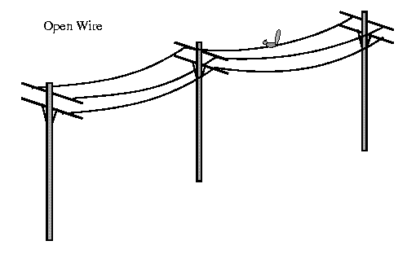
Open wire
Open electric wires
No shielding or protection from external noise
Cannot be used for data transmission but for less distances.

Slide 39
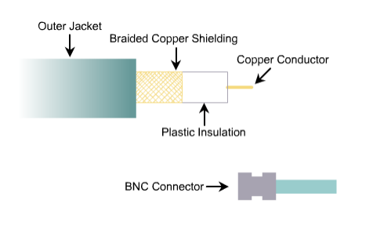
Coaxial cable
Outer shield protects inner shield from outer electric signals.
Similarly insulator between two conductors protects them from noise generated by either conductor.
Cable has 10 – 100 Mbps speed
Inexpensive
Maximum cable length 500m.
Coaxial cable offers several advantages for LAN.
Run longer distance then other cables.

Slide 40
Twisted pair
Wires are twisted in pairs
Each pair carries +ve and –ve signals
Noise appearing on one wire will also occur on other wire of same pair.
Noise appeared on both wires of pair will cancel its affect.
Twists of pair cancels the noise affect.
Increase in the number of turns per foot reduces noise interference.
Types of twisted pair
Shielded twisted pair
Unshielded twisted pair

Slide 41
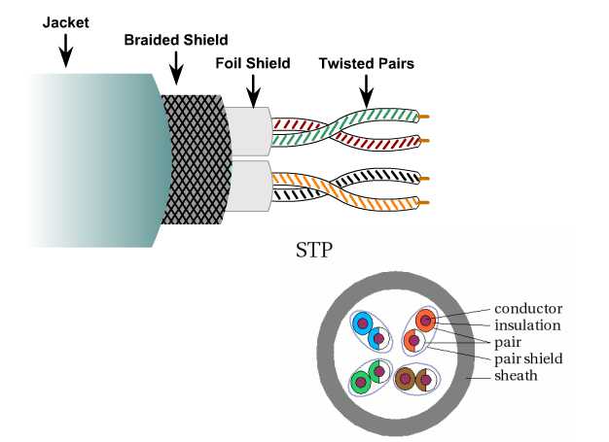
Shielded Twisted pair
STP cable combine the techniques of cancellation, shielding and twisted wires.
Each pair wrapped in metallic foil, then two pairs are wrapped in overall metallic foil.

Slide 42
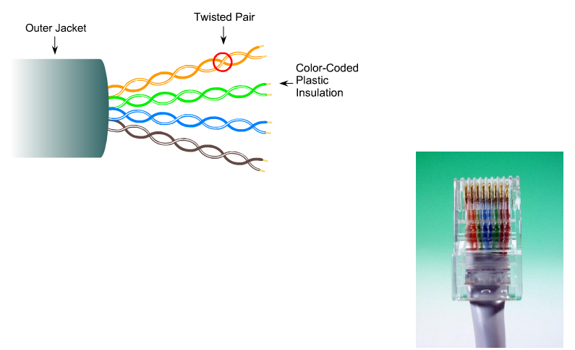
Unshielded Twisted pair
Eight cables, Four pairs
Each cable is covered with insulating material
Each pair is twisted around each other for cancellation effect
Uses RJ-45 connector

Slide 43
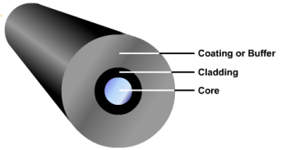
Optical Fiber
Data or information is transmitted as light pulses.
Carries more data for longer distances and much more speed as compare to other media.
Requires more protection.
Optical fiber is not affected by outer noise.
No crosstalk.

Slide 44
Unguided media
Based on electromagnetic waves
Signals are broadcast
Electromagnetic spectrum
Radio waves & micro waves :3kHz to 300GHz
Infrared waves: 300GHz to 400GHz
Ways in which signals travel from source to destination.
Ground propagation (low frequency signals)
Sky propagation (higher frequency signals, reflected back to earth)

Slide 45
Modes Of Data Communication:
Simplex, half-duplex, and full-duplex are terms used to describe different communication modes or channels in data communication. These terms refer to the direction in which data can be transmitted between communicating devices.
Simplex: In simplex communication, data can only be transmitted in one direction. It is a one-way communication channel.
Radio broadcast, television broadcast.
Less flexible, as communication is one-way only.
Example: Traditional broadcast radio or television where the transmitter sends signals, and the receiver only receives them. The receiver cannot send signals back to the transmitter.

Slide 46
Half-Duplex: Half-duplex communication allows data transmission in both directions, but not simultaneously. The communication can switch between sending and receiving, but not at the same time.
Two-way communication, but not simultaneously (bidirectional, half at a time).
Walkie-talkies, traditional push-to-talk systems.
More flexible than simplex but less efficient than full-duplex due to the need to switch between sending and receiving.
Example: Two-way radios (walkie-talkies) operate in half-duplex mode. One person talks while the other listens, and vice versa. They cannot speak at the same time without interference.
Full-Duplex: Full-duplex communication allows simultaneous two-way communication. Data can be transmitted and received at the same time, providing a bidirectional communication channel.
Simultaneous two-way communication (bidirectional, full at a time).
Telephone conversations, most modern data communication (e.g., internet communication).
Most efficient for real-time, interactive communication as both parties can transmit and receive simultaneously.
Example: Telephone conversations over landlines or cellular networks are typically full-duplex. Both parties can talk and listen simultaneously without interrupting each other.

Slide 47
Network Topologies
6

Slide 48
Network Topology Types
Star network topology
Bus network topology
Ring network topology
Combined network topology
Tree network topology
Full-mesh network topology
Partial-mesh network topology

Slide 49
Network topology refers to the arrangement or layout of various interconnected elements (such as nodes, links, or devices) in a computer network. It describes how these components are connected and how data is transmitted between them.
Physical topology
Bus
Star
Ring
Mesh
Tree

Slide 50
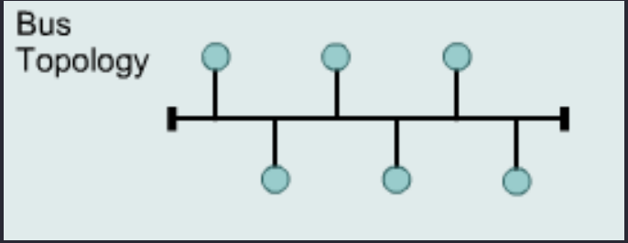
Bus
Uses single backbone cable, All hosts directly connected to this backbone.
Inexpensive and easy to install
All nodes receives data
Ends terminated with a device terminator.
Security issues are a common concern in bus topologies due to the shared communication medium

Slide 51
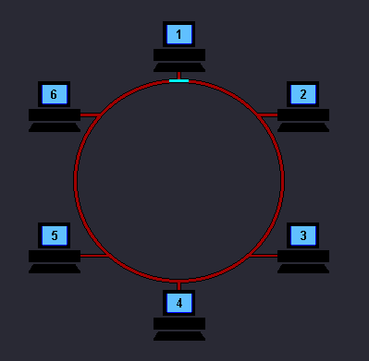
Ring
All nodes connected to one another in form of closed loop.
Expensive and difficult to install but offers high bandwidth, not robust.
Point to point connection with only two devices.
Signal is passed in one direction only, moves until it reaches to its destination.
One signal always circulates for fault detection.
If device don’t receives signal for specified time it generates alarm.

Slide 52
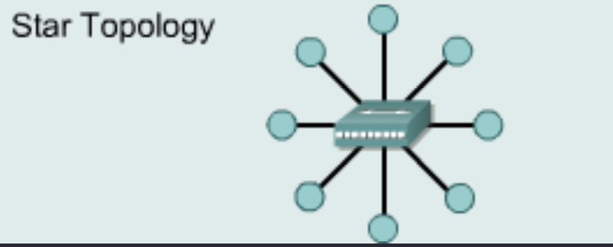
Star
Connects all devices with central point.
Central point can be hub.
Data transmitted reaches to central point, who decides where to send data.
Bottleneck occur because all data pass from hub.
Less expensive and easy to install, robust if one link is down still remains active.
Disadvantage: dependency one central unit.
Star is used in LANs.

Slide 53
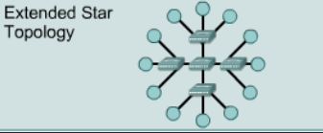
Types of STAR Topology
Extended STAR
Has one or more repeaters from central node to extend maximum transmission distance.
If repeaters in extended star topology is replace with hub or switches then it creates Hybrid topology.
Or if backbone as star topology and extended with bus then it also creates Hybrid topology.
Connecting two or more topologies with each other forms hybrid topology.

Slide 54
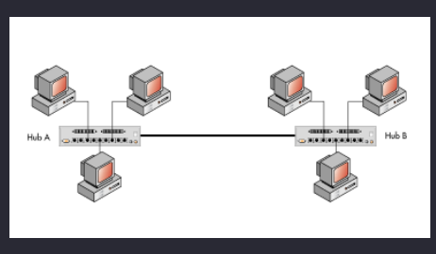
Types of STAR Topology
Distributed STAR
Individual networks based on star topology
These networks do not have central or top level connection points.

Slide 55
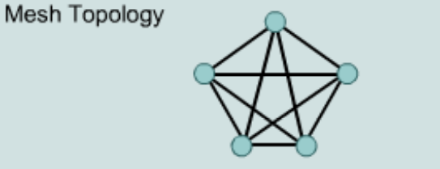
Mesh
Each host has its dedicated point to point link with every other host.
Link only carries data between two devices only (no other can use that link)
If link is multi directional or duplex mode then we need n(n-1)/2 links.
Each device requires n-1 I/O ports to be connected to each device.
Eliminates traffic problem, Robust, privacy/security of message.
More cabling required, more I/O ports needed, hard to install, expensive

Slide 56
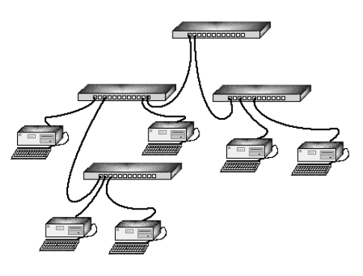
Tree
Central node connected to one or more nodes one level lower in hierarchy.
Combines characteristics of linear bus and star topology.
Must have three levels of hierarchy.
If only two levels then it forms star.
Disadvantage: requires point to point wiring, requires more hardware, dependent on backbone, difficult to configure.
Quiz
Identify the network topology in the following scenario along with reason:
(Assume Computer A, B, C, D, E, F, G, H are connected in network) –
i. Computer A sends a message across a network but it undergoes security issue.
ii. Computer B is the central computer and it failed to send message to other computers. , iil. Computer C switches off so entire network is down,
iv, Computer D, E, F, G, H undergoes redundancy of message.

Slide 57
My Answer Of Network Topology:
i. Security Issue with Message from Computer A:
Topology: Bus Topology
Reason: In a bus topology, all devices share a single communication line. If there is a security issue with a message from Computer A, it means that other devices on the bus can potentially intercept or access the message, indicating a security vulnerability associated with a shared medium.
ii. Central Computer B Failed to Send Message:
Topology: Star Topology
Reason: In a star topology, all devices are connected to a central hub (Computer B). If Computer B fails, it can result in a communication breakdown, as all communication passes through the central point.
iii. Computer C Switches Off, Entire Network Down:
Topology: Ring Topology
Reason: In a ring topology, each device is connected to exactly two other devices, forming a closed loop. If Computer C switches off, it breaks the ring, causing the entire network to be down as there is no continuous path for data transmission.
iv. Redundancy of Message for Computers D, E, F, G, H:
Topology: Mesh Topology or Bus Topology (Maybe)
Reason: In a mesh topology, every device is connected to every other device. Redundancy of messages (multiple paths) ensures that even if one path fails, alternative paths exist, preventing communication failures.

